Slide 1

From Vicarious Trauma to Burnout: An Introduction
Damir S. Utrzan, Ph.D., LMFT
Treatment Director and Group Supervisor
Licensed Marriage and Family Therapist
Board-Approved Clinical Supervisor

Slide 2
Disclaimer
The views expressed in this presentation do not represent those of the State of Minnesota, Department of Human Services (DHS), Division of Mental Health and Substance Abuse Treatment Services (MHSATS), or Minnesota Specialty Health System (MSHS).

Slide 3
Agenda
Define Important Terms
Discuss Impact of Caring for Traumatized Clients
Address Impact of Vicarious Trauma on Individuals and Organizations
Identify Strategies to Reduce Individual and Organizational Impact

Slide 4
Knowledge and Understanding
What do you know?

Slide 5

Juliette Watt | TEDxFargo

Slide 6
Important Terms

Slide 7
Defining | Traumatic Stress
“[…] stress response to a traumatic event in which one is either a victim or witness.” Involves, but is not limited to:
Real or perceived threat to physical and/or emotional (i.e., psychological) well-being.
Results in intense feelings of fear and lack of control.
Leads to feeling helpless.
Changes way self, others, and the world is understood.

Slide 8
Defining | Vicarious Trauma
“Transformation in self of helping professional due to empathic engagement with traumatized client(s) and their experiences.”

Slide 9
Defining | Secondary Trauma
“[…] the natural consequent behaviors and emotions resulting from knowing about a traumatized event experienced by another […] the stress resulting from helping or wanting to help a traumatized or suffering person.”
Charles Figley, Ph.D.
Paul Henry Kurzweg MD Distinguished Chair and Professor
School of Social Work
Tulane University

Slide 10
Defining | Compassion Fatigue
“[…] stress response to a traumatic event in which one is either a victim or witness.” Involves, but is not limited to:
Real or perceived threat to physical and/or emotional (i.e., psychological) well-being.
Results in intense feelings of fear and lack of control.
Leads to feeling helpless.
Changes way self, others, and the world is understood.

Slide 11
Differences | Traumatic Stress and Vicarious Trauma
Traumatic Stress | Vicarious Trauma
Extreme Emotionality | Over-Involvement or Avoidance
Increased Startle Response | Hypervigilance
Flashbacks | Intrusive Thoughts and Images
Despite many similarities, primary difference is that vicarious trauma (i.e., hearing about a traumatic event) does not lead to post-traumatic stress disorder [PTSD]).

Slide 12
Defining | Burnout
“[…] state of physical or emotional [psychological] exhaustion that involves reduced accomplishment and loss of identity.” Symptoms include, but are not limited to:
Cynicism and Criticalness
Inability to Arrive on Time
Irritable or Impatient
Lack of Satisfaction

Slide 13
Similarities| Traumatic Stress and Vicarious Trauma
Vicarious Trauma
Secondary Trauma
Compassion Fatigue
Burnout

Slide 14

Amy Cunningham| TEDxSanAntonio

Slide 15
Knowledge and Understanding
What do you think?

Slide 16
Individual Impact of Trauma

Slide 17
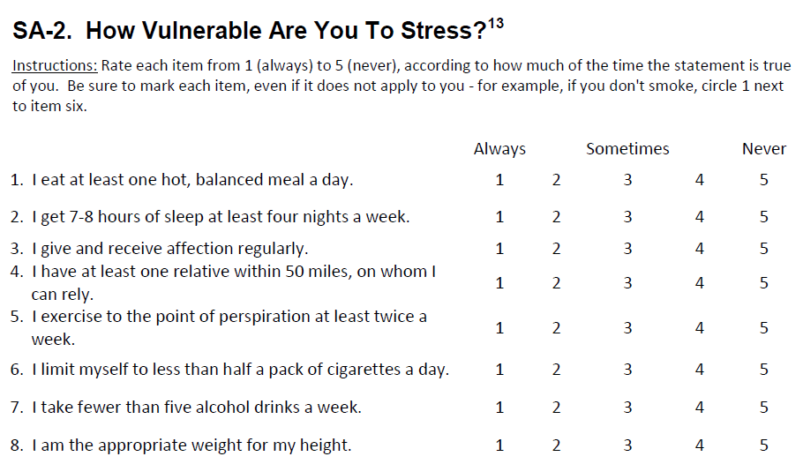
Vulnerability to Stress Scale

Slide 18
Vulnerability to Stress Scale | Scoring
Pair and Share
(5-Minutes)

Slide 19
Vulnerability to Stress Scale | Interpreting
Score | Stress Resistance
Below 10 | Excellent
Over 30 | Some Vulnerability
Over 50 | Serious Vulnerability
Total Score _________ - 20 = _________

Slide 20
Risk Factors | Personal and Professional
Personal | Professional
Trauma History | Absence of Supervision
Mental Health Problems | High Caseload
Young Age | Limited Experience
Isolation | Employee/Employer Mismatch
Loss | Absence of Support System

Slide 21
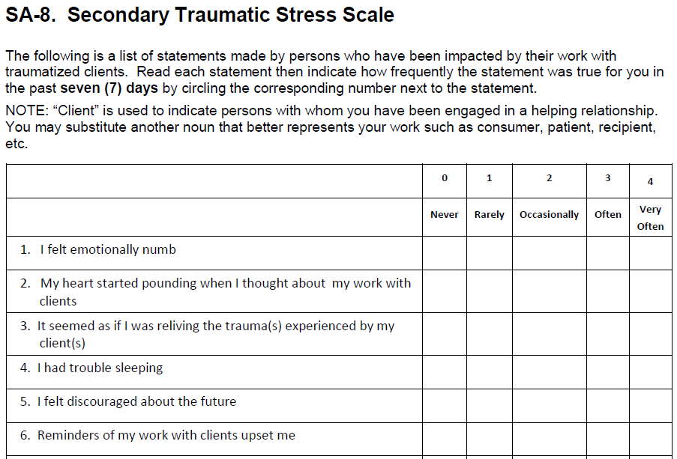
Secondary Trauma Stress Scale

Slide 22
Secondary Trauma Stress Scale| Interpreting
Score | Traumatic Stress Presence
27 or Below | Little or None
28 to 37 | Mild
38 to 43 | Moderate
44-48 | High
49 or Over | Severe

Slide 23
Impact of Trauma on Organizations

Slide 24
Trauma Impact| Organizations
Lost
Productivity
Organizational Illness
Staff Turnover

Slide 25
Statistics| Organizations
StackNation surveyed 568 people across 26 different industries in the United States and found that:
17% attributed a “negative work environment [or] culture” for quitting their job.
22% felt disengaged at work.
12% who felt disengaged from work were also not challenged.
5% felt that the culture at work was “toxic.”
5% felt unhappy at work.
25% were not excited about coming to work.

Slide 26
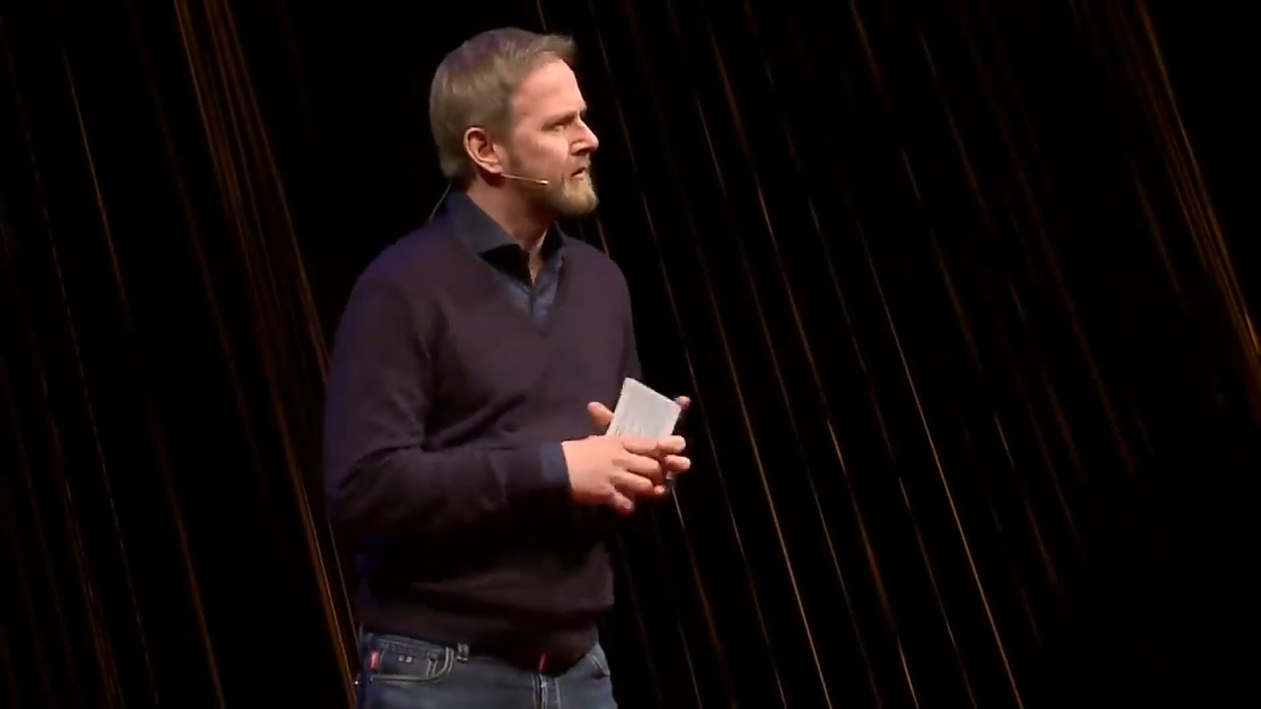
Glen Rolfsen| TEDxOslo

Slide 27
Strategies to Reduce Impact of Organizational Trauma

Slide 28
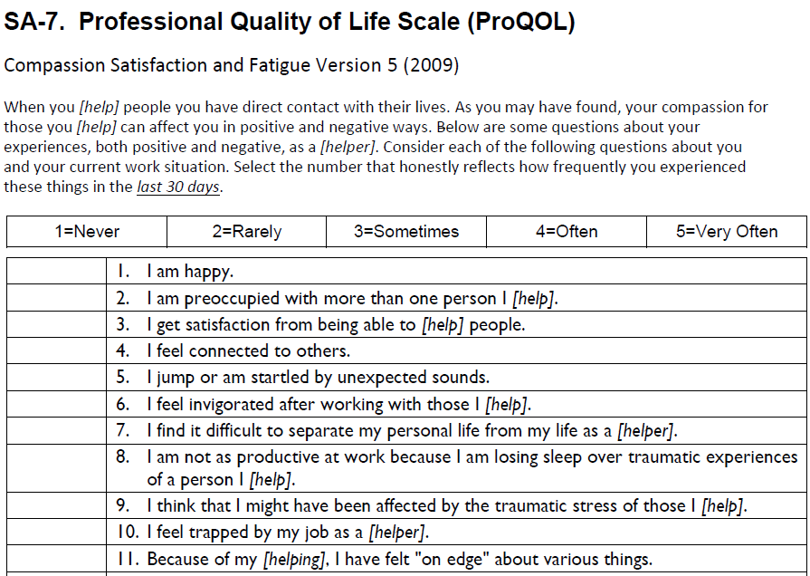
Reducing Trauma| Professional Quality of Life Scale

Slide 29
Burnout Sub-Scale| Interpreting
Total | Burnout Level
22 or Less | Low
23 to 41 | Average
42 or More | High

Slide 30
Reducing Trauma | Triple Filter Test
True
Is what I am about to say true?
Good
Is what I am about to say good?
Useful
Is what I am about to say useful?

Slide 31
Reducing Trauma | Organization
Reducing organizational impact of traumatic stress requires changing the culture. This can be accomplished by:
Supportive Leadership
Quality Supervision
Staff Debriefing
Team Meetings and Retreats
Formal and Informal Peer Support
Training and Education
Participating in Wellness Program

Slide 32
Reducing Secondary Trauma| Peer Support
Effective Communication
Trust
Conflict Resolution
Collaboration

Slide 33
Thank You
Damir S. Utrzan, Ph.D., LMFT
Damir.S.Utrzan@state.mn.us
Department of Human Services
Division of Mental Health and Substance Abuse Treatment Services
Minnesota Complex Health System

